Slide 1
AFCEA in Europe
Kaiserslautern Military Community Chapter 158
Lt Col Mike Williams
Chief Master Sergeant Ed Daly

Slide 2
KMC Chapter 158 “vital stats”
HQ: Ramstein AB, Germany
Members: 258
YAFCEANs: of which 137 are YAFCEANs
Average Luncheon Size / Attendance: >100 average
Sponsors: 1 Diamond, 3 Platinum, 12 Gold, 2 Silver, 3 Bronze
Budget: $117K Reserve (20-30K yr in expenses)
Scholarship: FY19 $16K, FY20 $19K
Notes:
FY19 Scholarships:
3x $5,000 High School Scholarships
3x $400 Chapter Scholarships
Total Amount Distributed: $16,200
FY20 Scholarships/Grants:
3x $300 Chapter Scholarships (Jan 2020)
$4999.81 Bloodhound Education Grant (Jan 2020)
$600.00 Ramstein H.S. Robotics Team Grant (Feb 2020)
Total Amount Distributed (as of Feb 2020): $6,499.81
FY20 Projected Scholarships/Grants:
Grants: $1400.19
Q2 Chapter Scholarships: x3 $300
Q3 Chapter Scholarships: x3 $300
Q4 Chapter Scholarships: x3 $300
Q4 H.S. Scholarships: x3 $5,000
Projected Scholarships/Grants: $19,100.19
Diamond:
World Wide Technology
Platinum:
Cisco
CDW-G
Splunk
Gold:
Integrated Technologies Group, Incorporated
Trusted Systems, Incorporated
Atlantic Communications Technology Corporation
Envistacom
Microsoft
Rubrik
Palo Alto Networks
Global Knowledge
Dell
VMWare
Ironbow
Juniper Networks
Silver:
Verizon
Siemens
Bronze:
F5 Networks
PacStar
NetApp
Budget: Total expense of $24K. Start with $117K and end with $93K.

Slide 3
KMC Chapter 158 Best Practices
Practice 1: Chapter 158 is consistent in messaging & marketing
Summary: Consistency is key
Details: Committee leadership takes an active interest in connecting industry to military. Senior mentors (Chapter Pres + x2 VP’s) contact all Comm/Cyber leadership 2 weeks out
Results: Great turnout! Average of 100 mil/industry each luncheon
Practice 2: Chapter 158 Scheduler drives a schedule 6 months out
Summary: A forecast schedule is a great indicator of success
Details: The scheduler (VPs) are working a schedule 6 months out. Ensures that our industry partners know when they’re ‘up to bat’ and when we can bring in senior military leaders to speak.
Results: Results in well planned events and garner’s interest (especially when general officer/military speakers participate)

Slide 4
KMC Chapter 158 Best Practices
Practice 3: Europe + Summer + Senior Mentors = Success!
Summary: Summer Expo is a great time for new Chapter business!
Details: Summer Expo every year, invites new partners and we bring a Senior Mentor to stimulate connections/networking.
1st Kickoff event: Belgian Beer at the Belgian Bistro…need I say more?
2d Kickoff event: Breakfast event which always brings a crowd (last year’s speaker was Gen Basham, this year’s will be Gen Harrigian)
Base-wide advertisement & support results in broad participation by many cyber/comm Airmen (Officer, SNCO, NCO)
Golf Tournament which lashes industry to military members in a casual + fun environment
Excellent opportunity to introduce new industry partners and bring on Young AFCEANs!
Results: Yet another opportunity to showcase what AFCEA is all about!

Slide 5
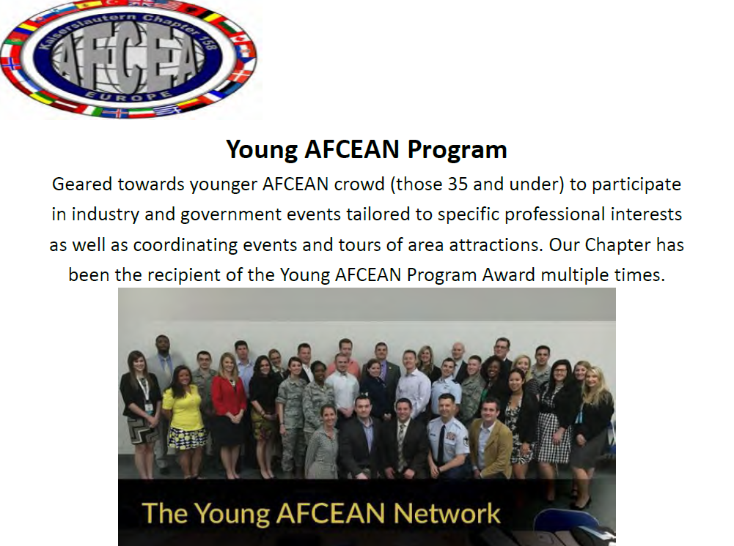
Examples of the material we use to advertise, gain support and reach a very wide audience.
Between a very pro-active leadership committee and great YAFCEAN program leaders we typically have large participation and great networking opportunities!

